Slide 1
Prison Management
System

Slide 2
Prison Management System
BY
SAIPRADEEP RAVIPUDI
(O5A41A1232)
Under the Guidance of
Asst.prof Miss T. SUBHASHINI

Slide 3
ABSTRACT
This project is aimed at developing “PRISON MANAGEMENT SYSTEM” that is a collection of registers and reports for the effective management of prisons.
Governments and prison services around the world are undergoing processes of renewal and reform that pose new challenges and opportunities in prison management. These same challenges and opportunities demand new knowledge, skills and leadership abilities
This system contains the modules like nominal roll, case register, parole register, Interview requests, In-out register and an automated release diary generator.

Slide 4
INTRODUCTION
1. Decreasing the overall size of the prison bureaucracy
2. Strengthening the policy-making role of senior officials
3. Shift in the role of bureaucrats from policy initiators to policy advisors and implementers
4. A decentralization of central administration functions
5. A strengthening of the policy and technical support systems

Slide 5
EXISTING SYSTEM:
The present existing system is manual system, which requires lots of man power. The scope of existing system is very limited. Existing system sometimes may lag in accuracy of its output. The ease of using the system is very less. The reports may not be generated at proper time and it becomes difficult for both visitors and jailors.

Slide 6
PROPOSED SYSTEM:
Automating the present existing system would help the organizations save its time, manpower, accuracy (precision) to a great extent. Data related to the organizations is to be stored and persistency of data is difficult in a manual system hence we go for an automating device computer to store our data.

Slide 7
NEED FOR AUTOMATION:
One very important reason to automate is that the visitors and jailors can easily access the information on a single mouse click. The information technology is all set to bring ease and accuracy in the work there by saving the man power. This also saves the time to a great extent.

Slide 8
BENEFITS OF PROPOSED SYSTEM:
Increase jail efficiency with customized modules to handle visitation, officer logs, sentencing, adjustments and classifications.
2. Save time and eliminate errors with easily accessible information
3. Find what you need and eliminate re-entry with advanced search capabilities

Slide 9
CONTINUED..
4. Uniquely and consistently manage across multiple facilities
5. Effectively manage visitors
6. Accurately and uniformly enter data

Slide 10
MODULES AND ITS DESCRIPTION:
JAILOR MODULE
VISITOR MODULE

Slide 11
JAILOR LOGIN:
The login of jailor is identified by unique id and password when you get authentication you can access the jailor services.
The jailor services comprise the following:
PRISONER DETAILS: Prisoner details comprises of all the details regarding prisoner which includes prisoner id, name, address, age, gender, physical details etc.
CASE REGISTER : Case register comprises details of the cases resisted against the prisoners which include theft, forgery, and murder etc.

Slide 12
CONTINUED..
PAROLE REGISTER: Parole register comprises the details of the prisoners who are on bail and other permissions which include referee address, no of days on bail.
RELEASE DAIRY: Release dairy gives release dates of the prisoners.
LOGOUT: When jailor clicks on LOGOUT he exits from the services and return back to home page

Slide 13
VISITOR LOGIN:
A visitor is identified by unique id and password if the visitor is new then he needs to signup to get access of visitor’s services.
When the visitor get authentication then he can access the following services.
REGISTER: In the REGISTER module the prisoner enters the date of visit and the name of the prisoner he is going to meet and this get submitted to jailor.
CHECK STATUS: CHECK STATUS tells whether the visitor is granted permission to visit or not, all these permissions are handled by the jailor.
LOGOUT: When visitor clicks on logout he exits from the services and return back to home page.

Slide 14
SYSTEM REQUIREMENT SPECIFICATION:
HARDWARE REQUIREMENTS:
IBM PC or Server
SOFTWARE REQUIREMENTS:
1. SQL SERVER
2. JAVA
3. INTERNET EXPLORER
4. WINDOWS XP

Slide 15
OVERVIEW OF THE PROJECT:
Visitor
Jailer
Nominal Roll
Case register
Parole register
In-out register
Prisoner-wise Reports
Release Diary
Visitor-wise Reports
Interview requests

Slide 16
REQUIREMENTS SPECIFICATION
1. The system should have a login (jailor, visitor)
2. In-out register modules for visitors
3. System should support for Data Entry module for Nominal Roll, Case register
4. Automated release diary generator.
5.Report Generation

Slide 17
DATABASE FIELD SPECIFICATION
No. | Field Name | Range of valid values for the field | Remarks
1 | Prisoner id | 1 to 1000 | Primary key
2 | Case id | 1-10000
3 | Name | Up to 15 characters in length. | Special characters like underscore are not allowed.
4 | Sex | flag | M/F
5 | type | Pre-definedset(like engineers/managers/etc) | Type of sentence : Duration specific, life time,
6 | Entry-date | Date
7 | Last-date | Date
8 | Duration of sentence | 1-10000 | No of days
9 | Height | 1-500 | Height in cms
10 | Weight | 1-700 | In Kgs
11 | Address | Up to 15 characters in length. | Permanent address of prisoner
12 | Status | 1-3 | 1: in jail 2:on parole 3: released 4:dead
NOMINAL ROLL

Slide 18
No. | Field Name | Range of valid values for the field | Remarks
1 | Case id | 1-10000 | Primary key
2 | Name | Up to 15 characters in length. | Special characters like underscore are not allowed.
3 | Type | 1-10 | 1.Theft 2.Murder 3.Forgery 4.counterfieting
CASE REGISTER
No. | Field Name | Range of valid values for the field | Remarks
1 | Visitor id | 1-10000 | Primary key
2 | Visitor name | Up to 15 characters in length.
3 | Registered on | Date
4 | Relation to Prisoner | Up to 15 characters in length.
5 | Age | 1-100 | Number
6 | Sex | Flag | M/F
7 | No of visits | 1-1000 | Number of visits since registration
8 | Status | Flag | Visitor approval/rejection
9 | Remarks | Up to 45 characters in length. | In case of rejection remarks are mandatory
VISITOR TABLE

Slide 19
PAROLE REGISTER
No. | Field Name | Range of valid values for the field | Remarks
1 | Prisoner id | 1 to 1000 | Primary key
2 | Name of Reference | Up to 15 characters in length. | Special characters like underscore are not allowed.
3 | Address of Reference | Up to 75 characters in length.
4 | Entry-date | Date
5 | Exit-date | Date
6 | Remand frequency days | 1-100 | Should visit Jail for remand
7 | Last remand visit status | T/F | In Kgs
8 | Last visited on | date

Slide 20
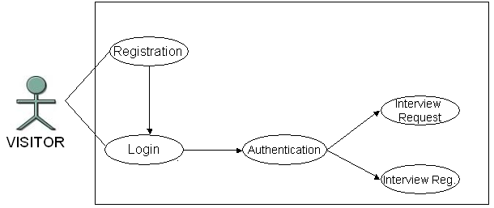
SYSTEM DESIGN AND DEVELOPMENT
Visitor level
  Highlevel Diagram

Slide 21
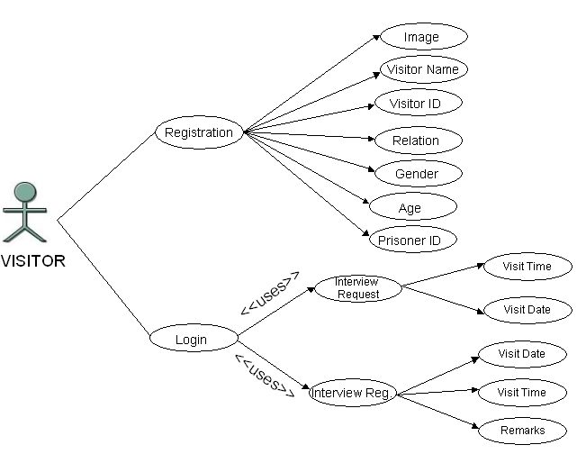
Visitor level
  Low-level Diagram

Slide 22
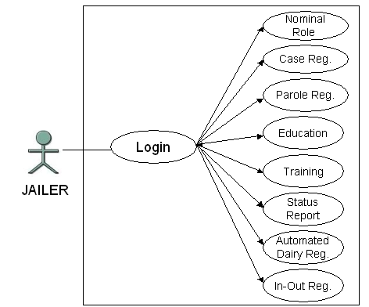
Jailor Level
  High level diagram

Slide 23
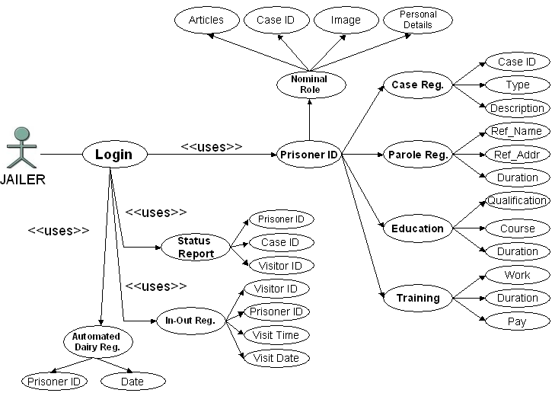
Jailor level
LowLevel diagram

Slide 24
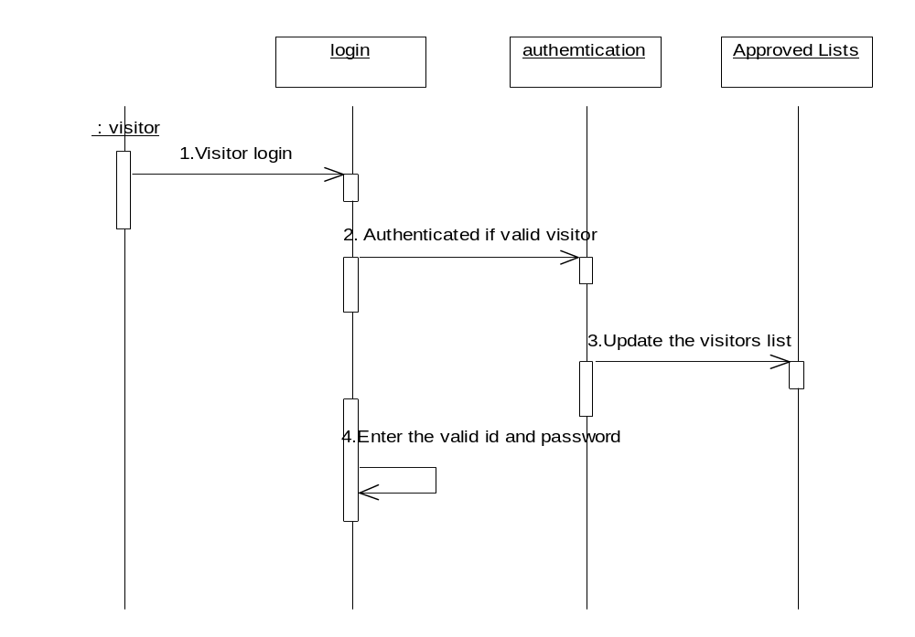
Visitor Sequence Diagram

Slide 25
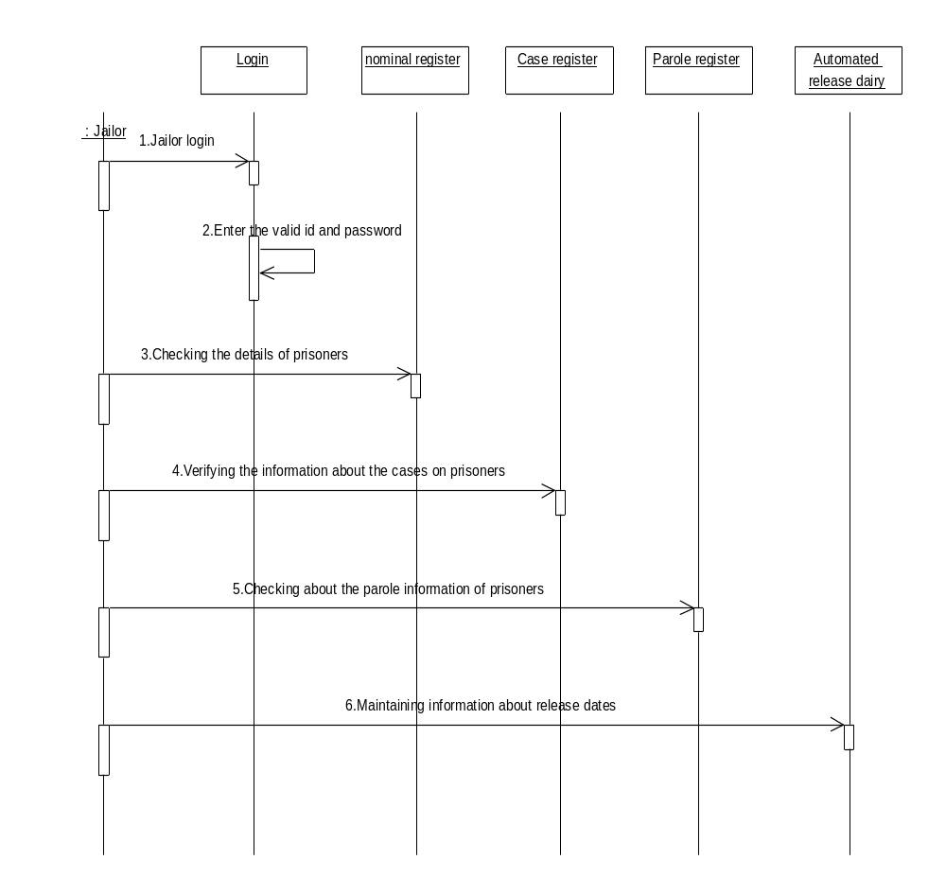
Jailor Sequence Diagram

Slide 26
CONCLUSION
Thus with this proposed system the manual work is reduced and effective handle the proceedings in the prison management.
References
www.W3schools.com
http://java.sun.com/products/jsp
http://www.jsptut.com/Getfamiliar.jsp

Slide 27
THANK YOU

